Slide 1


Living Income Toolkit
Take Action & Monitor Results

Slide 2
How to Use
This Living Income Toolkit Slide Deck was designed as a support resource for companies and is a supplement to the Toolkit “Guiding steps towards living income in the supply chain: How to mainstream living income in your company’s activities”. Please feel free to use this slide deck ppt for your own purposes, while maintaining the crediting included (all sources can be found in the notes section).
The complete Living Income Toolkit (pdf) is available online here:
Living Income Toolkit
Other Slide Deck resources are available, including:
Make the Case
Prepare for Action

Slide 3
Table of Contents
Step 6: Formulate living income strategy and set an internal policy and targets
Step 7: Assess and implement interventions
Step 8: Monitor results

Slide 4




Find Materiality, Benchmarking & Actual Incomes in the Living Income Toolkit “Prepare for Action”
Materiality
What raw materials will you focus on and in what location(s)?
Measurement & Evaluation
Are strategies working?
Benchmarking
Is there a benchmark for the location(s)?
Find Materiality, Benchmarking & Actual Incomes in the Living Income Toolkit “Prepare for Action”
Measurement & Evaluation informs strategy re-design
Strategy Development & Implementation
What strategies will you use to ”close the gap”?
Actual Incomes
Do you know farmers’ actual incomes?

Slide 5
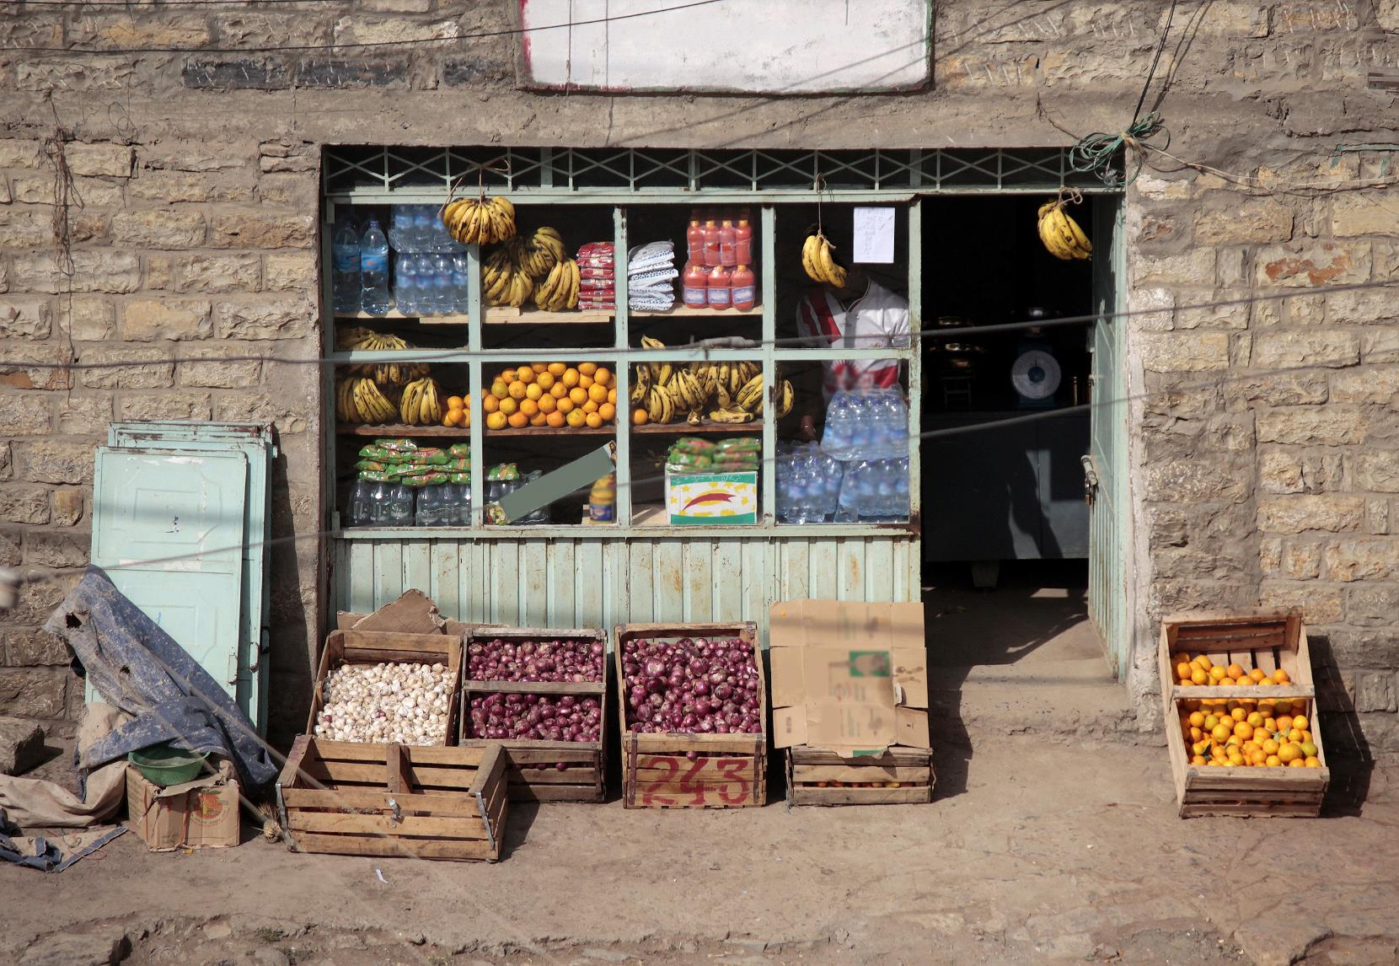
Step 6:
Formulate living income strategy and set an internal policy and targets

Slide 6
Creating a Living Income Strategy
Using information gleaned from research and benchmark information, you can create a living income strategy.
A living income strategy can and should align with current initiatives and goals.

Slide 7

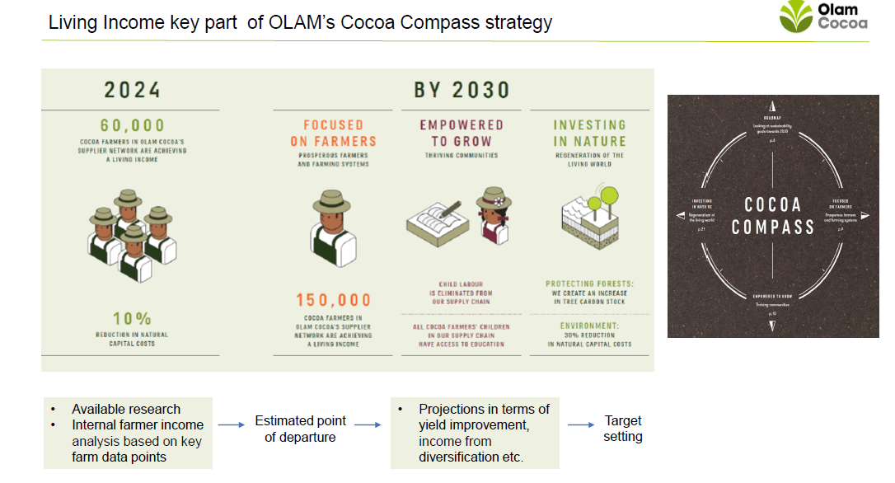
Company Spotlight

Slide 8

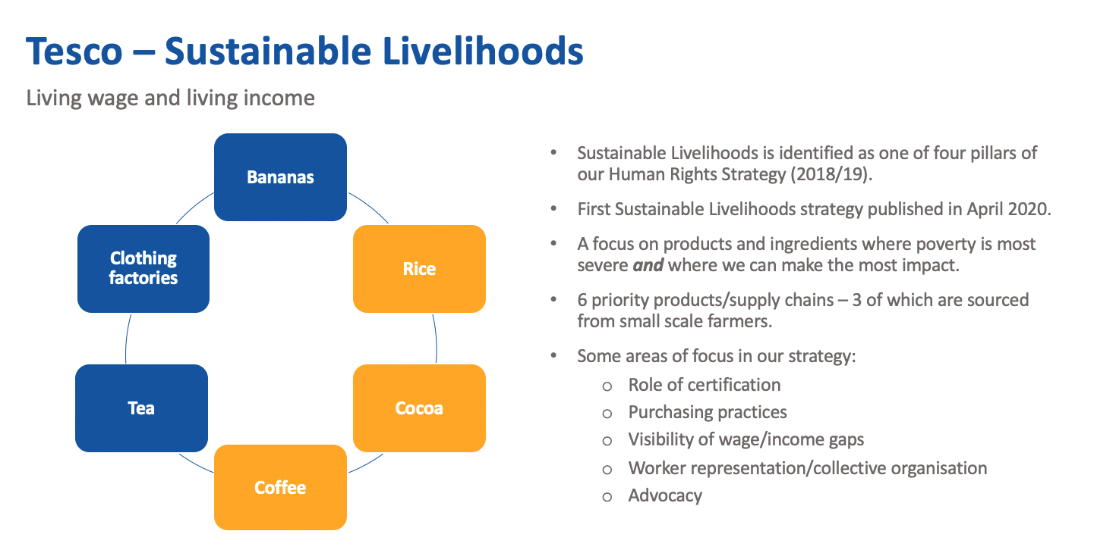
Company Spotlight

Slide 9
Policies & Targets
While creating a strategy it’s imperative to incentivize buyers to adopt responsible purchasing practices, including strategies to close income gaps. For that, traditional targets applied to procurement professionals can be reviewed, and the living income strategy can be supported through references within:
  • Individual performance agreements
  • Staff development evaluations and recognition arrangements (including financial incentive plans)
  • Category management objectives
See the Guide to Buying Responsibly: Ethical Trade Initiative
Notes:
https://www.ethicaltrade.org/sites/default/files/shared_resources/guide_to_buying_responsibly.pdf

Slide 10
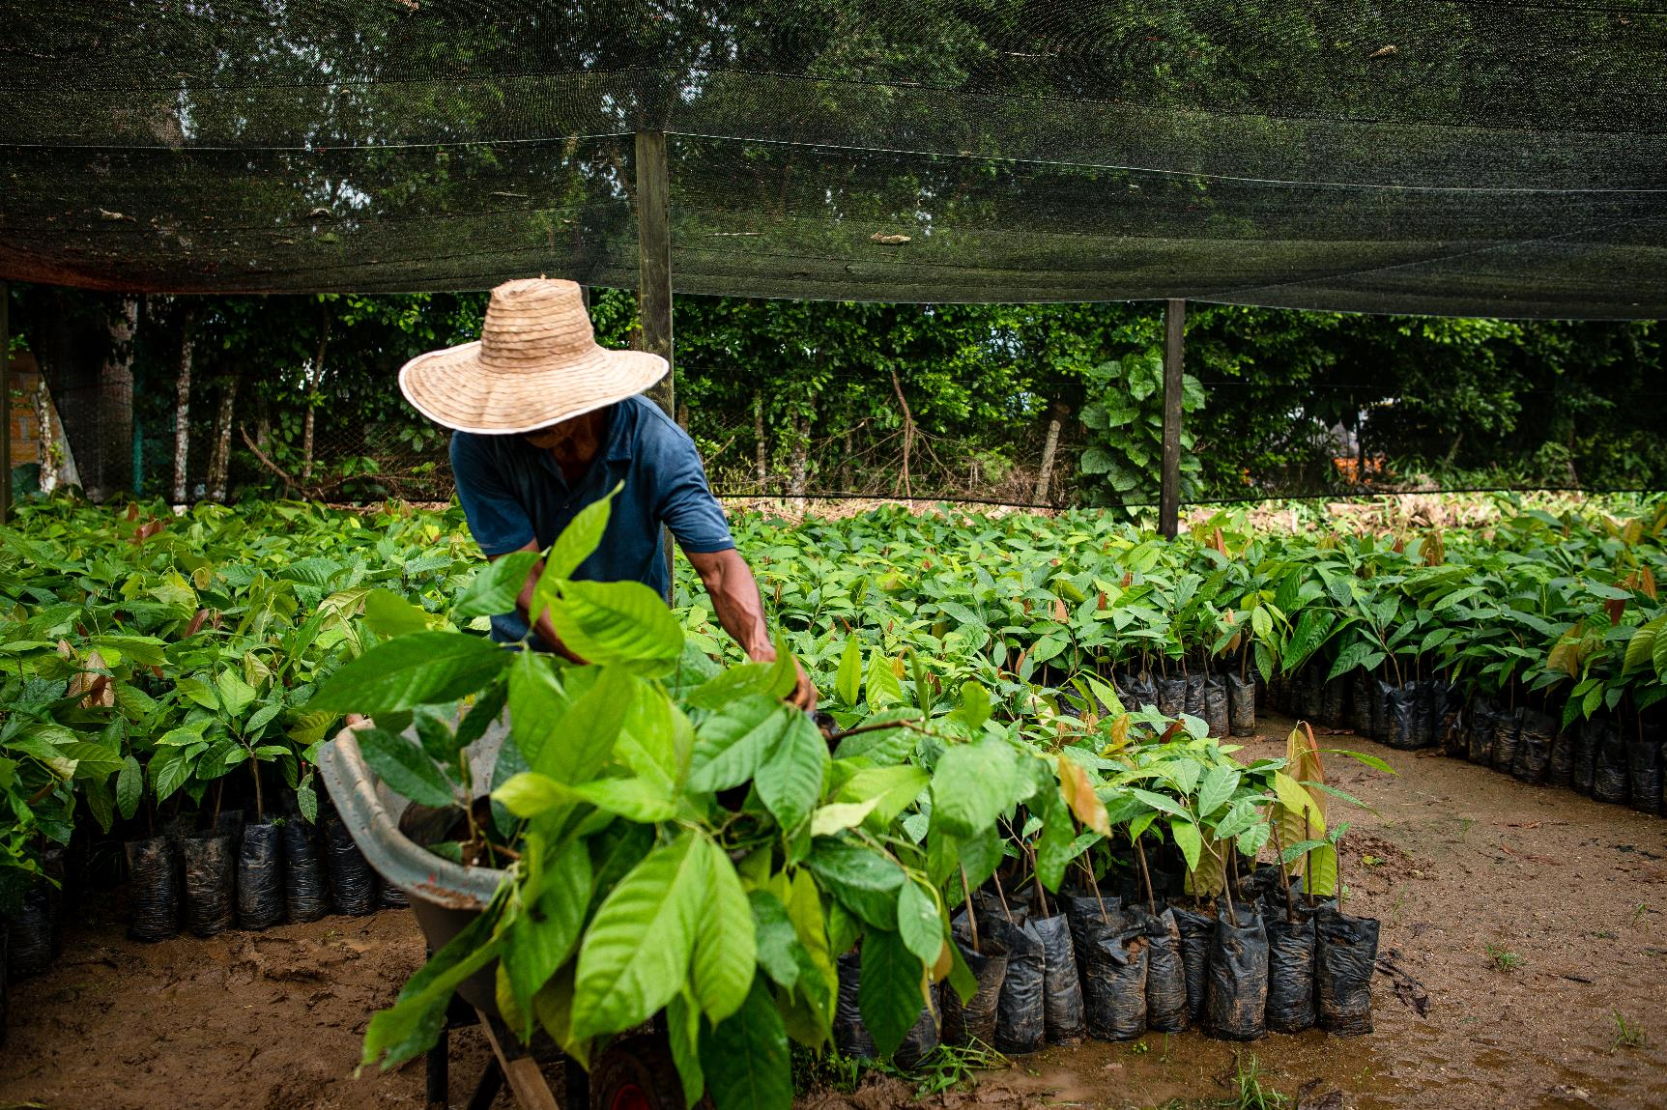
Step 7:
Assess and Implement Interventions

Slide 11



How can your company help close the gap to a living income?
The next step is to better assess the challenges and opportunities facing farmers in your supply chain to see how your company – through business practices, support for programmes that directly serve farmers or participation in precompetitive sector change – can contribute to improving the income of farmers.
Income for a farming household comes from four main sources:
  Cash from your company’s primary crop
  Cash from other crops
  Other forms of off-farm income
  Food crops grown on-farm (thereby reducing the need to buy food)
Potential household income
OTHER SOURCES OF INCOME
NET OFF-FARM INCOME
INCOME GAP
PRIMARY CASH CROP INCOME
OTHER INCOME
NET OFF FARM INCOME
SECONDARY CROP INCOME
ACTUAL INCOME
NET FARM INCOME
PRODUCE CONSUMED AT HOME
Notes:
Resources: https://c69aa8ac-6965-42b2-abb7-0f0b86c23d2e.filesusr.com/ugd/0c5ab3_ebc28c6d1e9246d1bf4770b071ef77ad.pdf
Initially, it is important to understand the challenges and opportunities that farmers face when it comes to income.
These can include low productivity, low prices, small land parcels, high dependency and poor quality. Many smallscale farmers may also lack the kinds of services that they need to make improvements – access to technical experts, affordable finance, quality inputs, etc. In farming systems where there are large productivity or quality gaps, many companies set up supply chain programmes that bring more services to farmers in order to help them improve their production practices. Investing in supply chain farmer supports programmes that offer on-the-ground solutions. These types of programmes can provide much-needed services and support to farmers to help them improve production practices, productivity and therefore incomes. However, experience has shown that these farmer support programmes are only successful when farmers see a positive return at a reasonable risk. In recent years, programmes in cocoa and coffee that have promoted productivity improvement have struggled because prices were too low to justify farmer investment and
volatility too high to motivate practice change even with appropriate farmer support services. Companies must look at their business practices to understand if they could bring more value and stability to the farmers through the way they buy or market goods. For example, engaging in longer-term contracts or increasing the price paid to farmers can allow farmers to feel more confident in investing in their farm. In addition, if farmers are facing structural or landscape-level challenges that a company cannot generally tackle alone, collaborating at the sector level can allow you to effect change more broadly. This can allow your company to engage more effectively with issues such as deforestation or watershed management at the landscape level, or governsuch as market management or fair tax legislation at a sector level.

Slide 12



Key Levers
A Living Income strategy must include multiple interventions. At minimum interventions should include
Net Farm Income Levers: including price, productivity and cost of production.
Price
Productivity
Cost of
Production
NET FARM
INCOME

Slide 13
Interventions are Interconnected
Profitability of alternatives
Understanding the whole system and how each intervention effects other components of a farmer’s income is crucial.
Attractiveness of crop relative to alternatives
Price
Pressure to improve profitability/ha
Productivity
Demand
Supply

Slide 14
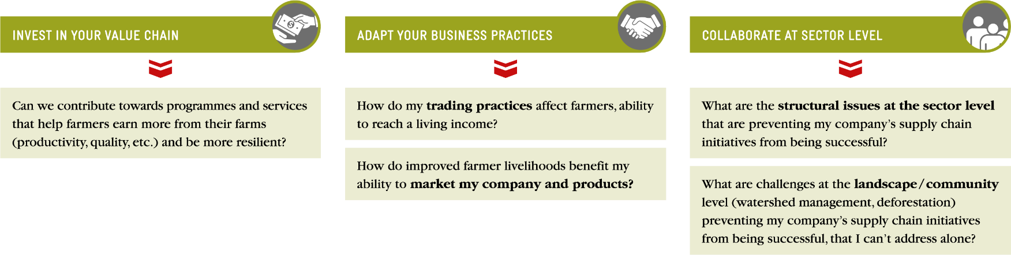
Choosing Pathway Interventions
Notes:
Some interventions require collaboration at the sector level while others are best completed within your direct value chain. Understanding how to influence and where to influence interventions is key.

Slide 15

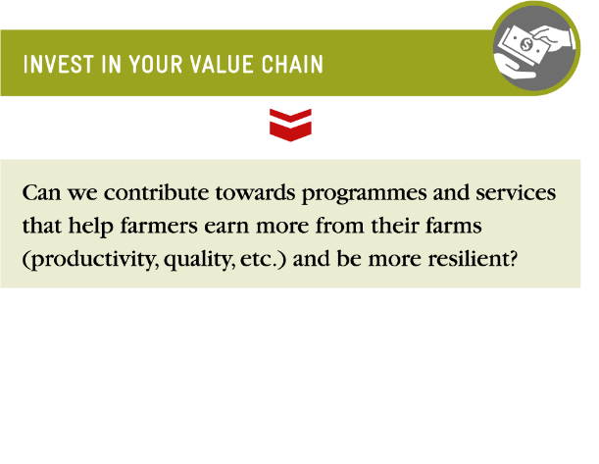
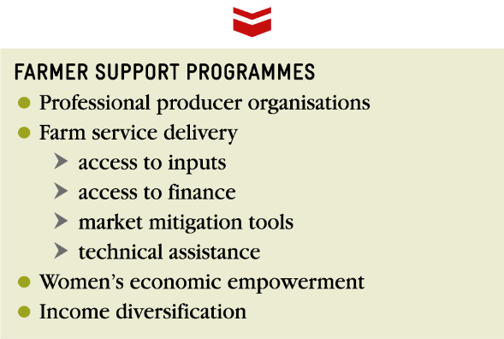
Invest in Your Value Chain
Identify current barriers to farmer success that can be helped through a supply chain intervention
(low crop yield, poor quality, etc.)
Understand root causes
(insufficient access to quality inputs, poor agricultural practices, no access to finance, climate change adaptation needed, etc.)
Design corresponding solutions that address root causes
(subsidised access to inputs, farmer field schools, promote income diversification, provide direct credit, etc.)
Identify partners and roles
Prioritize action based on severity of the need and potential for progress

Slide 16

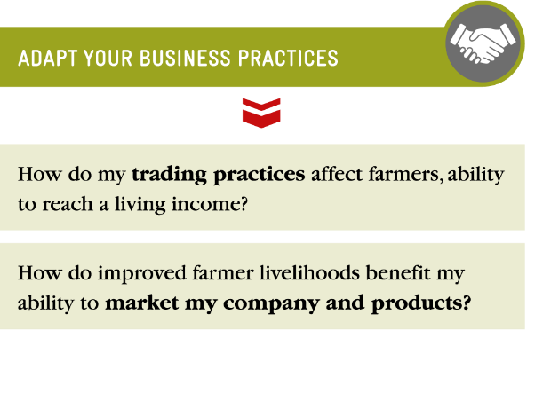
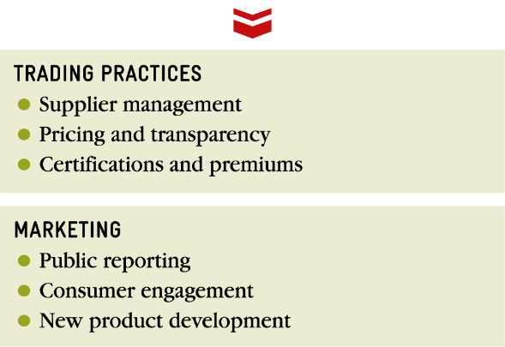
Adapt your Business Practices
Review core business practices
  Supplier Management
  Pricing and transparency
  Certification and premiums
  Marketing and consumer education
Adaptation of business and trading practices that include the introduction of risk-sharing mechanisms that can deliver certainty or more consistent value to the farmer
Creation of transparent and inclusive business practices that benefit farmers through the clear communication of standards, quality requirements and pricing
Notes:
A company’s principal role is to buy and sell goods or services. When considering how your company can have significant impact for farmers’ incomes, an analysis of your current business practices will help to ensure that those practices are contributing to this goal. At a minimum, the company’s business practices do not cause harm, and at best, they can be adapted to optimise the impact on improved farmer income. Typically, a company’s commercial leverage, its ‘buy’, is significantly larger than any philanthropic or add-on investment programme and, as such, can be a powerful focus of leverage in terms of how to contribute to living incomes.

Slide 17

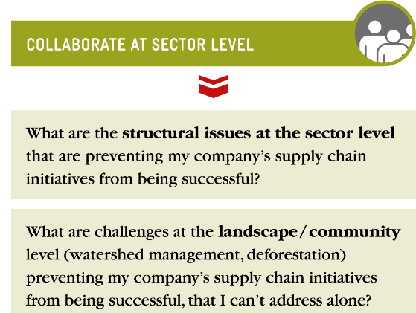
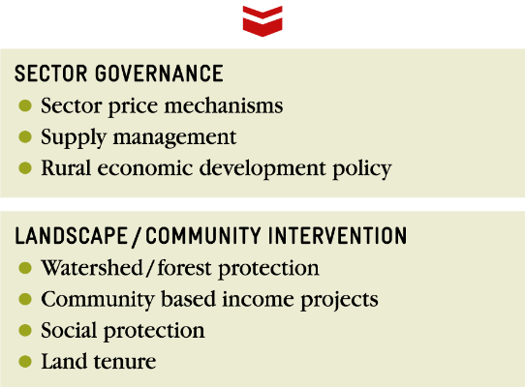
Collaborate at the Sector Level
Determine sector platforms that are addressing structural issues that are difficult for your company to address alone
Consider how your company can support, leverage or influence those platforms
Understand the regional social and environmental challenges faced by the smallholders in your supply chain (water, social services, land tenure, etc.)
Provide leadership or support through partnerships to address those issues
Notes:
To reach sustainability at scale, supply chains need to operate in well-functioning sectors and landscapes whose challenges are better suited to collaborative work. This type of pre-competitive work is valuable for sectors as a whole and also boosts the success of individual supply chain projects by providing the enabling environment in which producers can be successful now and in the future. When sourcing from poorly functioning sectors, you and your producer partners are much more prone to price and production volatility and weak service provision and organisation that leads to supply insecurity, a bad quality
reputation and reduced incentives for producer investment, among other negative impacts. Through platforms or project work, your company can collaborate with others facing similar challenges and engage with government, civil society and communities who can bring different assets to the table for collaborative solutions.
Sustainable Food Lab. An Overview of Sector Governance. Looking beyond the value chain to build high performing and resilient agricultural sectors. 2018.
https://sustainablefoodlab.org/wp-content/uploads/2018/02/Sector-Governance-Short-Paper-Jan2018v2.pdf

Slide 18

There Are Multiple Pathways to a Living Income
In any one supply chain there might be multiple ways to close the Income Gap depending on assets and goals.
  Status Quo
  Specialization
  Diversification
  Transition
  Farming family invests in productivity, quality, market knowledge and land allocation to main cash crop.
  Farming family increases productivity and quality of main cash crop, while investing in other crops with viable markets.
  Farming family is not able to reach a living income from only agriculture because of external challenges (i.e. land size) and employ alternative livelihood strategies that result in off-farm income.
Inclusion first: Leaving farmers who need to transition out of a strategy is not part of a living income strategy.
Notes:
How can your company help close the gap to a living income? The next step is to better assess the challenges and opportunities facing farmers in your supply chain to see how your company – through business practices, support for programmes that directly serve farmers or participation in precompetitive sector change – can contribute to improving the income of farmers.
There are many intervention options that will have varying results for varying stakeholders. There is not a simple or one size fits all intervention. When looking to support income, a company may pursue just one of these pathways or all of them in parallel. Within these pathways, your company will also need to make decisions around 1) which interventions are most appropriate for the challenges producers are facing, and 2) whether to target resources to either support a large number of farmers to a lesser degree (scale) or to support a small number of farmers to a large degree (depth).

Slide 19




Choosing Interventions by Income Type
Levers
Strategies
Action Pathway
  Social Services & Safety Nets
  Asset Development
Land tenure
Social protection
Potential household income
OTHER SOURCES OF INCOME
Collaborate at
the sector level
  Economic Development
  Asset Development
Women’s economic empowerment
Business development
Financial training & savings
NET OFF-FARM INCOME
Collaborate at
the sector level
Invest in your value chain
  Price
  Productivity
  Cost of Production
  Market Access
Professionalize producer organizations
Provide farm service delivery
Introduce better trading practices
INCOME GAP
PRIMARY CASH CROP INCOME
Collaborate at
the sector level
Invest in your value chain
Adapt your business practices
  Price
  Productivity
  Cost of Production
  Market Access
Professionalize producer organizations
Provide farm service delivery
Introduce better trading practices
OTHER INCOME
NET OFF FARM INCOME
Collaborate at
the sector level
Invest in your value chain
Adapt your business practices
SECONDARY CROP INCOME
  Lower Cost of Living
  Food Security & Resilience
Provide farm service delivery
Women’s economic empowerment
ACTUAL INCOME
NET FARM INCOME
PRODUCE CONSUMED AT HOME
Collaborate at
the sector level
Invest in your value chain

Slide 20



Increasing Net Farm Income
Return
to
income sources
Levers
Strategies
  Price
  Productivity
  Cost of Production
  Market Access
Invest in your value chain
Professionalize producer organizations providing farmers with the best access to farm services, improved marketing & prices.
Provide farm service delivery such as: inputs, access to finance, technical services, market access and risk mitigation tools.
Introduce better trading practices such as: supply management, pricing & transparency, and certifications & premiums.
PRIMARY CASH CROP INCOME
Collaborate at
the sector level
Adapt your business practices
  Price
  Productivity
  Cost of Production
  Market Access
Professionalize producer organizations providing farmers with the best access to farm services, improved marketing & prices.
Provide farm service delivery such as: inputs, access to finance, technical services, market access and risk mitigation tools.
Introduce better trading practices such as: supply management, pricing & transparency, and certifications & premiums.
SECONDARY CROP INCOME
  Lower cost of living
  Food security
  & resilience
Provide farm service delivery such as: inputs, access to finance, technical services, market access and risk mitigation tools.
Women’s economic empowerment.
NET FARM INCOME
PRODUCE CONSUMED AT HOME

Slide 21
Return
to
income sources
Increasing Net Off-Farm Income
Levers
Strategies
  Economic Development
  Asset Development
Collaborate at
the sector level
Invest in your value chain
Women’s economic empowerment
Business Development
Financial Training & Savings
NET OFF-FARM INCOME
NET OFF FARM INCOME

Slide 22
Return
to
income sources
Increasing Other Income
Levers
Strategies
  Social Services & Safety Nets
  Asset Development
Collaborate at
the sector level
Social protection
Land tenure
OTHER SOURCES OF INCOME
OTHER INCOME

Slide 23
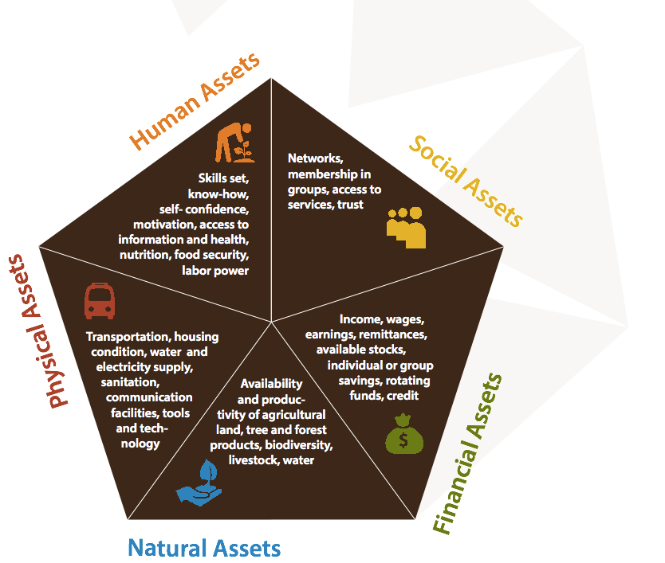
Asset Development
Return
to
income sources
Why
Asset Development is best laid out by the Sustainable Livelihoods Framework developed by DFID. The approach is founded on a belief that people require a range of assets to achieve positive livelihood outcomes, including the ability to earn a living income. The Sustainable Livelihoods Framework identifies five types of assets, or capitals, upon which livelihoods are built, namely human capital, social capital, natural capital, physical capital and financial capital. As assets become available or increase, there is a direct relationship to a smallholder family’s resilience and ability to earn a living income.
What
By collaborating at the sector level and engaging with governments, companies can assist in asset development. Policies, institutions and processes can determine access (to various types of capital, to livelihood strategies and to decision-making bodies and source of influence), terms of exchange between different types of capitals, and returns to any given livelihood strategy (DFID, 2000).
Social Assets
Financial Assets
Informed by DFID’s Sustainable Livelihoods Pentagon
Notes:
https://www.gov.uk/government/organisations/department-for-international-development/about
http://www.glopp.ch/B7/en/multimedia/B7_1_pdf2.pdf
https://www.livelihoodscentre.org/documents/114097690/114438878/Sustainable+livelihoods+guidance+sheets.pdf/594e5ea6-99a9-2a4e-f288-cbb4ae4bea8b?t=1569512091877

Slide 24

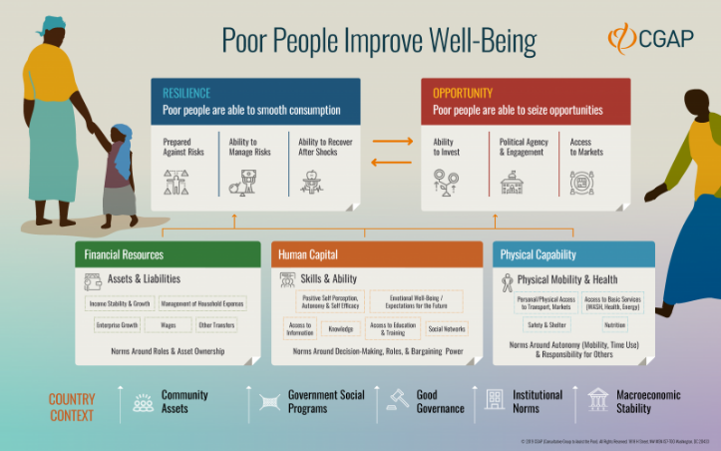
Asset Development Example
Return
to
income sources
Consultative Group to Assist the Poor
CGAP is a global partnership of more than 30 leading development organizations that works to advance the lives of poor people through financial inclusion. They have a vision of a world where poor people, especially women, are empowered to capture opportunities and build resilience through financial services.
Notes:
https://www.cgap.org/about
https://www.cgap.org/blog/financial-inclusion-what

Slide 25
Cost of Production
Return
to
income sources
Why
When the cost of production, including the cost of implementing suggested good agricultural practices (GAPS), is higher than the price received by farmers, that crop is almost certainly not supporting a farmer in reaching a living income. Cost of production should be be low enough—relative to price—to allow for the farmer to reinvest in his/her farm. For many smallholder farmers this is not the case, and they are forced to “hang in” due to lack of alternatives and high barriers of exit as their productivity decreases and they fall further into poverty.
What
Companies should work to understand the cost of production for farmers. Do farmers have access to quality affordable inputs? Are there any ways to reduce cost of production or smooth it over the year? What types of tools could help farmers track their actual production costs and revenues, providing them with the best information to make on-farm decisions.

Slide 26

Cost of Production Example
Return
to
income sources
Cargill Training Coaches in Cote d’Ivoire
Together with partners, ANADER (Agence Nationale D’appui au Développment Rural) and ICRAF (International Center for Research in Agroforestry), Cargill is training more than 1,000 coaches in Côte d’Ivoire. Together, they will help around 70,000 farmers to create and implement Farm Development Plans, helping farmers to increase their profitability by becoming more efficient and cost- conscious as they also increase productivity.
Notes:
Sources
https://www.cargill.com/doc/1432076281104/ccp-making-a-living.pdf

Slide 27
Economic Development
Return
to
income sources
Why
Smallholder farming families often have income generating activities offside the farm. When Economic Development takes place in a community, smallholder families benefit through potential increased earnings of current activities and the opportunity for new income generating activities, which help to support a living income.
What
Economic development can include increased market access, business skills training and business development, and other activities increase wealth within local communities through employment and improved household incomes.

Slide 28
Economic Development Examples
Return
to
income sources
Yam Sector Development in Ghana
The Alliances for Action Ghana (A4A) is a multi-stakeholder initiative started by the Government of Ghana, ITC and IITA, aiming to enable more inclusive and sustainable market systems for agribusiness. It brings together private and public actors with the aim to promote partnerships, invest in income diversification for smallholder farmers and MSMEs, improve commercial linkages and target multiple products and markets. As part of their work, A4A has created a Yam Sector Development plan, seeking to create a profitable export market and increase in-country processing.
Notes:
https://www.agrilinks.org/post/creating-inclusive-and-sustainable-agribusiness-systems-through-alliances-action
https://www.intracen.org/news/Ghana-becomes-first-country-to-launch-yam-strategy/

Slide 29
Food Security & Resilience
Return
to
income sources
Why
The cost of food often represents a large portion of total household costs for smallholder farming families, many of which face seasonal or year-round food insecurity. Food insecurity and malnutrition can negatively affect current and future family health, child development and productivity. At the same time, high food costs can inhibit farmers from earning a living income.
What
Understanding the cost of decent diet (which varies across regions) and providing educational support and programming the promoting food crop diversification can help smallholder families reduce their food costs, improve food security, and move closer toward earning a living income. The addition of livestock on a farm can also have food security and resilience benefits while contributing to improved dietary diversity and nutrition, which is vital to ensuring general health and wellness.

Slide 30

Food Security & Resilience Examples
Return
to
income sources
Food 4 Farmers
Food 4 Farmers works with coffee farmers in Latin America, building capacity from the inside out by cultivating leadership and expertise locally that leads to lasting solutions. Their community-based partners build and sustain long-term, effective solutions to food insecurity. In Colombia, Food 4 Famers continues to work with Nuevo Futuro, and have developed the following tools and strategies to help the community improve food security, nutrition, and livelihoods:
  A food security curriculum to educate families and embed knowledge within communities—focusing on women, because they purchase and prepare family meals — about healthy diets, food storage techniques to prevent waste, and other topics.
  Home gardens with water management systems to combat water issues, a key challenge to sustaining home gardens.
  Chicken and egg production to provide a regular source of protein for families and supplement their coffee income with local sales.
  Farm diversification to reduce reliance on coffee, improve nutrition, supplement income, and restore farm biodiversity.
Notes:
Sources
https://food4farmers.org/our-projects/colombia/

Slide 31
Lower Cost of Living
Return
to
income sources
Why
Similar to the cost of a decent diet, the cost of living directly affects the ability of farming households to reach a Living Income. By understanding smallholders’ costs and availability of decent housing and other essential needs such as water, education, health care, transport and clothing, we can better understand how to “close the income gap”.
What
In some instances the creation of a local school, marketplace or health and wellness center can provide necessary essentials in close proximity and at a lower cost. For these essentials, and others like local access to clean water, smallholder families can increase their available time by reducing their travel time.

Slide 32


Lower Cost of Living Examples
Return
to
income sources
Acumen & Unilever Provide Efficient Cook Stoves
Understanding smallholder families need for clean cooking facilities, Unilever and Acumen teamed up in 2015 to provide families with low-cost, energy-efficient, wood-burning cook stoves. Beyond reducing the cost of living, through a more efficient stove Unilever and Acumen have provided the following benefits:
  Reduced health and environmental problems (by removing the need to use an open wood-burning fire (e.g. the “three-stone fire”)
  Reduction in time and costs as farmers can spend five to ten hours per week collecting firewood and up to a third of their income purchasing fuel
  Reduced deforestation, as 50 percent of the destruction of Africa’s forests is due to collection of firewood or wood for charcoal production. Efficiently designed cook stoves require up to 60 percent less fuel and emit less CO2 into the air.
Notes:
Sources
https://acumen.org/blog/press-releases/unilever-and-acumen-announce-investment-to-bring-cleaner-more-affordable-cook-stoves-to-smallholder-farmers-and-plantation-workers-in-east-africa/

Slide 33
Market Access
Return
to
income sources
Why
Despite their large numbers in agriculture, smallholder farmers are often excluded from formal value chains because barriers to entry are high, there is little infrastructure in rural areas and there is poor or no access to services and training. In order to secure supply from smallholders in remote and rural areas, companies must make markets inclusive by adapting business operations to meet smallholder needs.²⁰ When given the right support, smallholder farmers can be invaluable partners to companies. When provided information and access, they can produce a sustainable supply of premium quality products. As companies learn to work with smallholders, they can lower transaction costs and begin to reach economies of scale. In return, smallholders can receive increase prices as product quality improves. Furthermore, they can benefit from donor assistance as well as political and social capital associated with working with poor farmers to build rural economies.²¹
What
Tailor your business practices to the particular context to make it easier for smallholders to engage in the supply chain and ensure there is a path to meeting your company’s quality specifications.
  Ensure transparent price and quality information
  Adjust payment terms and contracts to minimize side selling
  Provide necessary training and services that help farmers meet your company specifications
  Incentivise suppliers to create income improvement strategies in areas of high poverty
  Ensure programs allow for and promote inclusion of women and youth
Notes:
20: The Inclusive Business Action Network has a wide library of resources and cases for successful approaches to inclusive business. https://www.inclusivebusiness.net/
21: Backgroundpaper Global Agro-Industries Forum. Business models that are inclusive of small farmers. 2008. https://sustainablefoo.wpengine.com/wp-content/uploads/2016/02/Inclusive-Business-Models.pdf

Slide 34


Market Access Examples
Return
to
income sources
Nestle Understanding Farmers’ Challenges
Nestlé has developed a global approach to conducting regional contextual assessments of its supply chain. It is called the Rural Development Framework. These assessments lay the foundation for identifying barriers and opportunities to improve livelihoods.
Valuelinks
Deutsche Gesellschaft für Internationale Zusammenarbeit (GIZ) GmbH has developed an action- oriented methodology called ValueLinks 2.0 that compiles the most important tools for value chain promotion. It provides the framework for a systematic approach to analysing value chains and the joint strategy development of value chain stakeholders. It aims to strengthen business linkages, service provision and the regulatory framework for improving competitiveness and stimulating sustainable and inclusive pro-poor growth. ValueLinks 2.0 refers to living incomes for discussing strategic considerations for value chain development and suggests using the concept for an informed dialogue between stakeholders on fair pricing policies and setting targets for value chain upgrading.
Cargill: Coop Academy
Cargill’s Coop Academy is aimed at empowering farmer organisations as a starting point for reaching farmers and their communities. The Coop Academy is a “mini-MBA programme” pairing classroom training with on-the-ground coaching to support leaders to improve how they run their businesses and support long-term cooperative growth. Since the start of the programme, 36% of cooperatives have now been rated as professional, up from 3% before engagement with the programme.
Notes:
Sources
Nestlé: https://www.nestle.com/csv/impact/rural-livelihoods
Cargill: https://www.cargill.com/story/cargill-coop-academy
ValueLinks Association e.V: http://www.valuelinks.org

Slide 35
Price
Return
to
income sources
Why
Smallholder farmers are often “price takers”, meaning that they are subject to the price provided by the world market. Price volatility is common in smallholder farming systems like cocoa, coffee and vanilla. The boom and bust cycle is caused by swings in supply and demand. When prices are low, farmers remain in a poverty trap and do not invest in their crop, leading to a possible reduction in quality. When prices rise, insecurity also rises, with theft prevalent in some commodities (like vanilla), or an increase in production, leading to oversupply and a low price. With a main cash crop making up a large portion of a smallholder farmer’s income, price is a key factor to income generation and stability.
What
A variety of pricing mechanisms exist to support farms to make a living income. Certifications and premiums, such as Fairtrade ensure that farmers are following sustainable practices, and in return receive a price premium. Living Income Reference Prices consider the price needed for an average farmer household with a viable farm size and an adequate productivity level for that crop to contribute to a farming family’s living income. Lastly, supply management has been utilized in some countries of origin, to help stabilize prices.

Slide 36

Price Example
Return
to
income sources
Fairtrade International Living Income Reference Price
The Fairtrade methodology is based on the following key parameters:
  Cost of a decent standard of living (Living Income benchmark)
  Sustainable yields (productivity benchmark)
  Viable farm size (to fully employ the available household labour)
  Cost of sustainable production (in order to achieve above mentioned yields)
Fairtrade has published Living Income Reference Prices for cocoa in Ghana and Cote d’Iviore and vanilla in Uganda and Madagascar.
Notes:
Sources
https://files.fairtrade.net/2019_FairtradeLivingIncomeReferencePrice_Model.pdf
https://files.fairtrade.net/2019_RevisedExplanatoryNote_FairtradeLivingIncomeReferencePriceCocoa.pdf
https://files.fairtrade.net/publications/Fairtrade_Vanilla_LivingIncomeReferencePrice_explanatorynote.pdf

Slide 37
Productivity
Return
to
income sources
Why
To reach a living income smallholder farmers generally need to reach a good productivity level. Productivity is directly related to cost of production, which influences overall income from a crop. In many cases smallholder farmers don’t have adequate funds to invest in their farm or access to resources such as inputs, technical assistance or financing needed to increase productivity. In some contexts, this is further exacerbated by climate change.
What
Increased productivity following good agricultural practices (GAPs) provides farmers with tools and resources that will improve resilience to climate change and increase yield. Supporting farmers both in building knowledge and changing attitudes around adopting good agricultural practices and linking them with the resources to help them to invest in these practices, can help farmers to achieve ideal yields that will in turn help them to earn a living income.

Slide 38

Productivity Example
Return
to
income sources
IITA’s Stepwise Approach
Farmers often know the types of practices needed but are unable to invest or unwilling to risk investment in climate smart practices that can increase their productivity. By breaking down the basket of recommended CSA practices into smaller, incremental steps, the IITA team has developed an innovative investment pathway (Stepwise) to make CSA adoption affordable for smallholder coffee farmers. Stepwise is easily adaptable to the varying needs and aspirations of coffee farmers and their agroecological site differences and thus presents a contextually specific set of climate smart practices for each region. Laying out specific practices in a way that factors in the resources and motivations of farmers helps to increase uptake and target company resources more effectively.
Notes:
Source
https://cgspace.cgiar.org/bitstream/handle/10568/80747/CSIP%20and%20Differentiation_CCAFS%20Info%20Note.pdf

Slide 39
Social Services & Safety Nets
Return
to
income sources
Why
Similar to lowering the cost of living, the provision of social services such as education, healthcare, land tenure and other safety nets provide farmers with resources that build resilience reduce costs and consequently the gap between an actual income and a living income.
What
Work with local governments and NGOs to understand current rules and regulations and the communities’ affordable access to these resources. Where farming families do not have access to basic services, companies may be able to use their influence and resources to help reduce costs and/or increase access.

Slide 40

Social Services & Safety Nets
Return
to
income sources
Vanilla for Change
In 2019 Unilever’s brand Wall’s launched the “Vanilla for Change” campaign. With this campaign, Unilever and its partners Save the Children, ME to WE and Symrise are helping families earn a sustainable living from vanilla farming, by improving resilience and empowering young people with skills and training. Programme activities have positively impacted over 40,000 people across 76 villages – including over 18,000 boys and girls who are benefiting from access to healthcare, education and training.
Notes:
https://www.symrise.com/newsroom/article/shaping-the-future-with-vanilla-symrise-and-unilever-support-young-people-on-madagascar-and-in-the/
https://www.wallsicecream.com/uk/inspire-me/me-to-we.html

Slide 41
Access to Finance/Economic Empowerment
Return
to
income sources
Why
Investing in tools, equipment and more advanced techniques is a way for smallholder farmers to increase yields and thus income. In some cases, investment is needed just to maintain quality and yields, such as in the case of aging tree stocks that need to be renovated and / or rehabilitated, like cocoa and coffee in some sourcing areas or where the effects of climate change are negatively affecting yields. Smallholder farmers are often risk averse when it comes to accessing financial services, and often rightfully so. Before investing, farmers must be able to:²⁶
  • Cover their family’s basic needs;
  • Have means to access financial services;
  • Have a reliable income source;
  • Be reasonably sure that they will receive adequate return on their investment.
What
Companies can:
• Promote financial literacy: Financial literacy is essential for farmers so they can manage their business efficiently, protect themselves against financial risks and access productive credit.²⁷ Education on investment management can help farmers to make smart decisions relating to savings and credit.
• Support farmer business schools: The provision of financial literacy training on topics such as farm record keeping and managing the costs of inputs in order to build the business has the capacity to enable sound decision-making and improve efficiency.²⁸
• Promote savings-led groups: Village savings and loans groups are self-managed, community-based groups that provide their members with access to basic financial services.²⁹ The main purpose is to provide simple loans to community members who do not have access to formal financial services.³⁰
• Facilitate access to formal financial services: Companies can facilitate access to finance by connecting farmers to financial institutions and providing offtake guarantees/ contracts, and / or by “drawing lenders’ attention to the security offered by the company’s ongoing local purchasing programmes”.³¹
• Provide direct credit: Where a company assesses the farmer’s creditworthiness more positively than a distant bank’s judgement, “it may be economical for the company to partially underwrite the risk of loans to farmers or farmers’ organisations”.³²
• Adjust financial services to farmers’ reality: Financial services should be available and ideally tailored to the unique needs of farmers. This includes, for instance, the provision of loans with flexible repayment terms in line with local crop planting and harvest cycles.³³
Notes:
26 InfoBridge. Towards an integrated approach for project analysis for small farmers: the Living Income / Fair Price method. 2014. https://www.share4dev.info/fairprice/documents/5218.pdf
27 Café Africa, Global Coffee Platform. Financial Literacy to Facilitate Access to Finance in Eastern Africa – an inventory of training tools and materials for coffee farmers. 2016. https://www.globalcoffeeplatform.org/assets/files/Financial-Literacy-training-tools-and-materials-for-African-coffee-farmers.pdf
28 IFPRI. The Impact of a farmer business school programme on incomes of smallholder farmers. 2018. https://www.ifpri.org/publication/impact-farmer-business-school-program-incomes-smallholder-farmers-insights-central
29, 33 Farmer Income Lab. What works to increase smallholder farmers’ income? A landscape review. 2018. https://www.farmerincomelab.com/sites/g/files/jydpyr621/files/2019-09/What%20Works_FINAL_9.19.pdf
30 Catholic Relief Services: Savings & Internal Lending Communities (SILC) – Field Agent Guide. 2019. https://www.crs.org/sites/default/files/tools-research/silc_fa_guide-5.1-final.pdf
31, 32 Sustainable Food Lab, Business Fights Poverty: Enabling smallholder farmers to improve their incomes. 2017. http://sustainablefoodlab.org/wp-content/uploads/2017/09/BFP-Improving-Incomes-WEB.pdf

Slide 42

Access to Finance/
Economic Empowerment Examples
Return
to
income sources
Government of Malawi’s Farmer Business Programs
The concept of the FBS was developed to build capacity among farmers, to improve their farm business knowledge and decision-making skills, and to change attitudes towards commercialization. The year-long group-based learning approach is aimed at equipping smallholder farmers to make better agricultural production decisions that can enhance productivity and farm incomes. In particular, training sessions that provide participants with information on best practices in time management, calculating break-even crop prices, crop husbandry practices, such as crop rotation and appropriate spacing, recordkeeping, searching markets for good prices, calculating profits and gross margins, and modern storage techniques provide smallholder with knowledge and decision making tools that increase incomes and independence.
Notes:
26 InfoBridge. Towards an integrated approach for project analysis for small farmers: the Living Income / Fair Price method. 2014. https://www.share4dev.info/fairprice/documents/5218.pdf
27 Café Africa, Global Coffee Platform. Financial Literacy to Facilitate Access to Finance in Eastern Africa – an inventory of training tools and materials for coffee farmers. 2016. https://www.globalcoffeeplatform.org/assets/files/Financial-Literacy-training-tools-and-materials-for-African-coffee-farmers.pdf
28 IFPRI. The Impact of a farmer business school programme on incomes of smallholder farmers. 2018. https://www.ifpri.org/publication/impact-farmer-business-school-program-incomes-smallholder-farmers-insights-central
29, 33 Farmer Income Lab. What works to increase smallholder farmers’ income? A landscape review. 2018. https://www.farmerincomelab.com/sites/g/files/jydpyr621/files/2019-09/What%20Works_FINAL_9.19.pdf
30 Catholic Relief Services: Savings & Internal Lending Communities (SILC) – Field Agent Guide. 2019. https://www.crs.org/sites/default/files/tools-research/silc_fa_guide-5.1-final.pdf
31, 32 Sustainable Food Lab, Business Fights Poverty: Enabling smallholder farmers to improve their incomes. 2017. http://sustainablefoodlab.org/wp-content/uploads/2017/09/BFP-Improving-Incomes-WEB.pdf

Slide 43
Access to Inputs
Return
to
income sources
Why
Access to affordable and quality inputs (seeds, fertilisers, pesticides, etc.) are critical for farmers’ productivity and their ability to produce quality products to meet specifications.
What
Companies may determine that farmers do not have access to quality inputs for a variety of reasons:
  1) They are not available,
  2) They are available but adulterated,
  3) They are available but farmers are unable to afford them, or
  4) Farmers do not see their value as worth the price.
Critical to the success of company interventions aimed at facilitating access to inputs is to pair inputs with the appropriate training on input use and complementary agricultural practices:
  • Facilitate access to input finance through a formal financial partner.
  • Companies provide inputs to the farmers at no cost or at subsidised rates before the planting season the costs of which are deducted from the sale price after harvest.²⁵
  • Companies provide information and training on the appropriate use of inputs.
Notes:
25. Sustainable Food Lab, Business Fights Poverty (2017): Enabling smallholder farmers to improve their incomes. 2017. http://sustainablefoodlab.org/wp-content/uploads/2017/09/BFP-Improving-Incomes-WEB.pdf

Slide 44


Access to Inputs Examples
Return
to
income sources
Neumann Kaffee Gruppe (NKG) Bloom: Transforming Smallholder Coffee Farmers’ Livelihoods
Through Farmer Services Units located in their export companies, NKG offers service packages to farmers, including financing assistance and capacity building. Under this initiative of NKG BLOOM, smallholder coffee farmers in Uganda receive cash advances and fertiliser for their coffee trees. This prevents farmers from going into debt with local money lenders or pre-selling their harvest at very low prices for immediate cash. Reimbursement can be made at harvest time. This helps break the cycle of poverty and debt that many farmers face. At the same time, NKG benefits from gaining access to high-quality coffee beans.
Revitalising the Malawi Tea Sector
The Strategic Alliance ”Towards Living Wages and Living Incomes for Tea Workers and Tea Farmers” in the scope of the Malawi 2020 Tea Revitalisation Programme supported smallholder tea farmers and rural workers employed on tea estates through collective bargaining, business management trainings, assisting communities in developing new businesses, and to establish saving schemes in Malawi. Achievements include wages for tea estate workers increased to levels 50% higher than the rural minimum wage in Malawi. Furthermore, the first ever collective bargaining agreement (CBA) was signed by the trade union for tea workers and the Tea Association of Malawi. 18,800 workers received a more nutritious diet fortified with essential minerals and vitamins, and in addition, all tea estates provided fresh vegetables once a week. Some estates created business opportunities for women to engage in growing vegetables on the estate. More than 2,000 smallholder farmers were trained in 66 farmer field schools. This is every sixth tea farmer in the country, two thirds of them being women. At these Farmer Field Schools, farmers build their knowledge and skills to improve the quality of their tea farming, business management and standard of living. 80 savings groups were formed to improve access to financial means.
Notes:
Sources:
Field Buzz: https://field.buzz/coffee-nkgbloom/
NKG BLOOM: https://uganda.nkgbloom.coffee/
Ethical Tea Partnership: https://www.ethicalteapartnership.org/improving-incomes-for-farmers-in-malawi/

Slide 45
Business Development
Return
to
income sources
Why
Business Development is a key part of Economic Development, helping to support viable business creation, professionalization of existing businesses and creating employment opportunities. As business development occurs, supplemental services are often provided such as education and health and wellness facilities.
What
Companies can support partners, such as cooperatives, with business development tools or work with sector or government partners to support more general business development: access to loans, training, creation of new sectors, policy creation, and/or access to quality education.

Slide 46

Business Development Example
Return
to
income sources
Cooperative Development Program (DCP)
Beyond seeking to improve productivity, the Cooperative Development Program works directly with cooperatives by providing services and support in governance, member equity and capitalization, financial management, market performance, legal and regulatory reform, gender inclusion, and youth engagement. In Peru, the Cooperative Development Program (CDP) is supporting sustainable livelihoods with Equal Exchange, a U.S.-based worker cooperative, and ACOPAGRO, a Peruvian cacao cooperative.
Notes:
https://www.usaid.gov/partnership-opportunities/ngo/cooperative-development-program

Slide 47
Diversification
Return
to
income sources
Why
Crop diversification is a promising strategy for increasing net household income and improving resilience. Farmers grow complementary crops on their farms which are sold as cash crops in the local or export markets or which reduce costs and improve food security as sustenance crops. As an added benefit, crop diversification helps to build resilience to environmental and economic shocks by spreading production and market risk. If focused on subsistence crops, crops can act as a food security safety net in the event of an income drop and can also contribute to improved dietary diversity and nutrition, which is vital to ensuring general health and wellness.
What
Before promoting a cash crop or off-farm income diversification strategy among your producer partners or in collaboration with a producer organisation, it is imperative to understand farming family interests and to support a business evaluation of the diversification options relative to goals, including:
farm-level analysis to understand what works for farming families in the agronomic context along with any restraints;
business model analysis to understand what opportunities are available and what is needed to make the diversification product profitable at the household level; and
what off-farm income generating opportunities exist in the region. Diversification interventions can promote women’s economic empowerment and decision-making by soliciting design input from all members of the targeted community/cooperative and implementing interventions that support women’s participation.

Slide 48
Diversification Cont.
Return
to
income sources
Types of Diversification
On-farm diversification – cash crop: Many people have identified cash crop diversification as a key climate and market volatility resilience strategy. However, efforts in this regard are often one-sided, favouring a primary crop and not equipping farmers with the resources or markets to successfully manage and sell the “diversification crop”. This presents an opportunity to engage multiple companies in supporting farmers in professional diversification that will increase farmer income, build resilience and help to grow a sustainable supply of more than one cash crop, given there is demand and access to markets.
On-farm diversification – subsistence crops: Improving food crop production in terms of quality, quantity and diversity of food grown for household consumption is a key strategy to reduce the costs of family dietary needs, stabilise income in the face of economic shock and promote health by offering a consistent source of nutritious food and a diversified diet. Companies can promote food crop production as part of their service delivery model by providing training and seeds. In some cases that same company can be the off-taker, which helps to ensure a market for farming families.
Off-farm diversification: Diversification into off-farm income sources can help grow farmer income and reduce climate and market risks. As with on-farm income, where a company is promoting a particular pathway to diversify income (i.e. by offering agricultural services or making and selling goods), it must be sure that a national or international market exists.

Slide 49

Diversification Examples
Return
to
income sources
PROVA and Barry Callebaut: Improving Vanilla Farmers’ Resilience Through Crop Diversification with Cocoa
To secure a sustainable vanilla supply, PROVA partnered up with Barry Callebaut, with support from IDH, in 2016 to engage in an on-the-ground project in Madagascar. The joint project aims to encourage farmer entrepreneurship, improve community livelihoods and secure a sustainable supply of vanilla by overcoming challenges linked to agriculture and market volatility. Additionally, the project supports farmers in diversifying their income by teaching them how to grow and process cocoa in anticipation of a potential upcoming price drop.
Notes:
Source
Sustainable Vanilla Initiative: https://www.idhsustainabletrade.com/vanilla-and-cocoa/

Slide 50
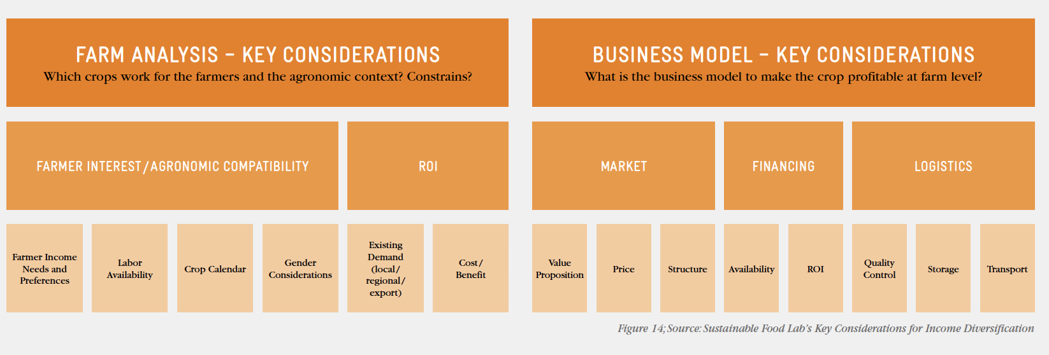
Other Considerations for Diversification
Notes:
While the living income movement has focused on the income gap that farmers may face with regard to the cost of a decent standard of living, it is important to recognize that annual income is not the only thing that farmers value and need. Cash flow throughout the year matters when it comes to food security. Assets (land, equipment, skills, etc.) support the capacity of households to earn income. And finally, resilience is the important ability to bounce back from weather and market shocks. Many of the above interventions address income, assets and / or resilience, all of which are necessary for farmers to achieve a decent standard of living over the long term.

Slide 51
Farmer Risk Mitigation
Return
to
income sources
Why
Company collaboration to share and reduce risks of investment for farmers can provide farmers with income reliability and unlock farmers’ capacity and willingness to invest.³⁴
What
As a company, you can use your leverage to build in risk mitigation or risk sharing tools, services and infrastructure that support a more stable income for farmers and support them to reinvest in their farms.
  • Crop / weather insurance: Crop insurance is a financial tool that farmers can use to protect themselves against the loss of crops due to natural disasters (e.g. floods, drought, blight) and pests. As a company, you can negotiate with providers that offer crop insurance to farmers or, where that is not feasible or desirable, you can also share the risk with farmers directly.³⁵
  • Post-harvest loss prevention: Post-harvest loss prevention programmes promote technologies and techniques that reduce the risk of crop loss and allow farmers to store their product in a time of low prices.³⁶ It ranges from packaging techniques to storage infrastructure.³⁷
Notes:
34 Farmer Income Lab. What works to increase smallholder farmers’ income? A landscape review. 2018. https://www.farmerincomelab.com/sites/g/files/jydpyr621/files/2019-09/What%20Works_FINAL_9.19.pdf
35,36 Sustainable Food Lab, Business Fights Poverty. Enabling smallholder farmers to improve their incomes.2017. http://sustainablefoodlab.org/wp-content/uploads/2017/09/BFP-Improving-Incomes-WEB.pdf
37 Muther, K. FSG. Yieldwise. Building a Better Food System in Africa Through Shared Value Partnerships. https://www.sharedvalue.org/resource/yieldwise/

Slide 52

Farmer Risk Mitigation Examples
Return
to
income sources
Weather Insurance for Kenyan Farmers
The Syngenta Foundation, the Kenyan insurance company UAP and Swiss Re Corporate Solutions teamed up to offer Kenyan farmers insurance to help them feel confident in investing in their farms in the face of climate change and harsh weather conditions. The Kilimo Salama model, designed specifically for smallholders, uses automated weather stations and mobile payments to provide insurance payouts instead of visiting individual farms. This model results in reduced administrative costs, which allows the project to provide insurance to thousands of farmers at a premium price they can afford.
Agricultural Business Analysis and Investment Training
Agricultural Business Analysis and Investment Training (AgBAIT) is a modular training approach that enables both emerging farmers and agri- based enterprises alike to analyse their current business operations and potential investments. For this purpose, a paper and an Excel-based support tool have been developed to calculate and analyse the envisaged investment options. In addition, AgBAIT offers participants the opportunity to get acquainted with the financing options of local financial institutions and to present their business and investment plan to these financial institutions.
Notes:
Sources
Syngenta Foundation: https://www.syngentafoundation.org/agricultural-insurance-Kenya
GIZ: https://www.giz.de/en/worldwide/42696.html

Slide 53
Financial Training & Services
Return
to
income sources
Why
Beyond financial and training services for on farm activities, financial training and services within the community can have a widespread effect on farming families’ ability to achieve a Living Income by helping them to better manage their money, build resilience, and invest in asset building.
What
Companies can partner to help communities establish financial institutions that provide community members with access to credit, financial training and savings opportunities.

Slide 54


Financial Training & Services
Examples
Return
to
income sources
CARE Village Savings and Loan Associations
Savings groups are self-managed groups of 15 to 25 people who meet regularly to save their money in a safe space, access small loans, and obtain emergency insurance. CARE has a special focus on including women and girls in financial decision making and since 1991 CARE has helped 8.4 million people join savings groups. By 2030 CARE has a goal of helping 65 million people.
Root Capital
Through Root Capital’s financial advisory services program, businesses (such as cooperatives) are able to overcome critical challenges through interactive, tailored training. Root Capital focuses on strategic, financial, and operational improvements essential for the continued success of each business they work with. Specific training and advisory includes designing inventory management systems and internal controls, improving accounting procedures and strengthening financial reporting and analysis, building enterprise resilience through stronger governance and executive leadership, and adoption of technological solutions to streamline operations and inform decision making.
Notes:
Resources:
https://www.care.org/our-work/education-and-work/microsavings/
https://rootcapital.org/how-to-apply-for-a-loan/advisory-services/

Slide 55
Land Tenure
Return
to
income sources
Why
Land is a critical resource for rural families, making land tenure one of the most important assets and indicators of economic wellbeing. For many small farmers, access to and rights to land and natural resources can be a root cause of conflict and the primary constraint on their ability and willingness to invest in their farm. Additionally, competing land uses can affect food security and natural resource management, both of which contribute to a sustainable livelihood. In rural communities, land is not only a fundamental building block for earning a living income, but also a source of identity and power linked to their ability to participate in community decision. This unequal access creates tenure insecurity, inhibiting their full participation in improving food security at the household and community level, and investing in and safeguarding the natural resource base.
What
Policies and laws governing land tenure don’t often provide equal access to, control over, and ownership of land and natural resources. Women and minority groups are further left behind as they have unequal access to and control over land and other assets. While not a barrier that companies can address alone, companies can contribute to this structural issue by working with local governments through partnerships and sector platforms.
Winrock, 2017
Notes:
Resource: https://www.winrock.org/wp-content/uploads/2017/08/AgNRM-Tenure-Assessment_CECOTAPS_08-15-2017_Final6.pdf

Slide 56

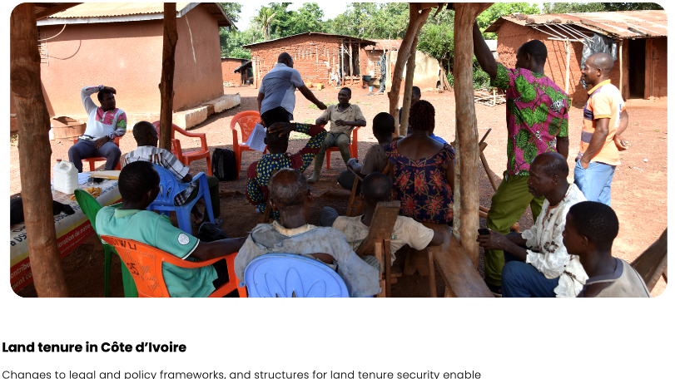
Land Tenure Example
Return
to
income sources
The Cote d’Ivoire Land Partnership (CLAP)
CLAP consists of The Hershey Company, Unilever, and Barry Callebaut Cocoa Horizons and the German Cocoa and Chocolate Foundation.
CLAP is endorsed by AFOR (Agence Foncière Rurale) and the World Cocoa Foundation, and managed by Meridia.
Cocoa farmers want to formalize their land rights, but can’t afford the full cost and require support. CLAP is a fit-for-purpose solution that is cost-effective, technology-based and participatory to support the Ivorian government, the cocoa farmers and the private sector in securing land rights and the future of cocoa production in Côte d’Ivoire.
Notes:
Resource:
Source: https://www.meridia.land/cases/clap

Slide 57
Professional Producer Organizations
Return
to
income sources
Why
Smallholder farmers come together in different types of organisations (e.g. farmer producer organisations, cooperatives, federations, etc.) that empower them to make use of economies of scale and increase their collective bargaining power. Producer organisations may offer farmers the ability to negotiate for better access to inputs and financial services at lower prices, offer their own training on good agricultural practices and / or be able to sell to the market at higher prices.²² A professional producer organisation is a valuable business partner to a company sourcing its goods as it reduces transaction costs, can act as a consistent producer partner in improving yield and quality produced and sold, and can help a company to meet its sustainability (or farmer income) goals as an implementing partner to improve livelihoods.
What
Producer organisations vary in their level of maturity and professionalism. Depending on their need, your company may support cooperatives in different ways, including supporting the professionalisation of their business practices (internal management, operations, financial management) and the way they provide services to their farmers (sustainability, market access, external risk mitigation, access to inputs / credit / funding and capacity builders like services providers, etc.).²³
Notes:
22. Farmer Income Lab. What works to increase smallholder farmers’ income? A landscape review. 2018. https://www.farmerincomelab.com/sites/g/files/jydpyr621/files/2019-09/What%20Works_FINAL_9.19.pdf
23. Cargill. Farmer Organization. 2019. https://www.cargill.com/sustainability/cocoa/farmer-organizations
24. IDH. Service Delivery Models. 2019. https://www.idhsustainabletrade.com/approach/service-delivery-models/

Slide 58

Professional Producer Organizations
Examples
Return
to
income sources
Coop Norandino
Coop Norandino was founded in March 1995 with 200 members. Today the group has grown into a second level non-profit organization which represents coffee and sugar cane producers of the Piuran mountains of northeastern Peru. Norandino’s primary objectives are to sell 100% of their coffee to the specialty market, to strengthen their organization, and to establish respectful and collaborative commercial alliances with their international network of buyers. Members have worked collectively to improve quality and overall production under certified organic practices and increased their exports into specialty markets in North America, Europe and Asia. Farmers also enjoy access to financing and development projects, such as their large scale reforestation and carbon project with PurProject. This has facilitated the diversification of their production base to include a range of products from panela (raw brown sugar), jams and cocoa, to crafts and tourism.
Coop Coffees, 2020
Notes:
Resources:
https://coopcoffees.coop/norandino/
https://coopnorandino.com.pe

Slide 59
Service Delivery Model
Return
to
income sources
Why
Services are most effectively grouped together in a combined “service delivery model” that includes access to inputs, financing options and technical agronomic services. Service delivery models that reach farmers in an effective way and fulfill service gaps that act as barriers to farmer professionalisation are integral to ensuring farmers have the resources they need and the skills necessary to be productive, meet specifications, grow income and improve resilience. Service delivery may include integration with other strategies, such as a gender-inclusive approaches, youth-focused activities or the promotion of climate-smart practices. Service Delivery models are also not just appropriate for main cash crops but should be utilized for farmers interested in diversification.
What
To be successful, service delivery should benefit and be economically viable for all stakeholders, including value chain investors, service providers and farmers. As a value chain investor, service delivery is part of your core business, and making it clear that the farmer is the client of these services can lead to more effective delivery by your partner service provider.
Notes:
24: https://www.idhsustainabletrade.com/approach/service-delivery-models/

Slide 60

Service Delivery Model Example
Return
to
income sources
Sap and GIZ are Revolutionizing the Administration of a Farmers’ Organisation
Uganda is one of Africa’s largest coffee exporters, but the majority of its coffee is harvested by smallholders who have limited market access and therefore receive low prices. In 2005, the Uganda Coffee Farmers Alliance (UCFA) was formed which allowed farmers to secure higher prices. However, the organisation is labour-intensive and expensive to administer. SAP and the Deutsche Gesellschaft für Internationale Zusammenarbeit (GIZ) GmbH have, therefore, been collaborating as part of a develoPPP.de partnership with the UCFA. The develoPPP.de programme is implemented by GIZ on behalf of the German Federal Ministry for Economic Cooperation and Development (BMZ). By means of adapting SAP’s basic software to the local context and training 12 UCFA managers in using an app to record the quantity of coffee supplied by individual farmers, administration and accounting was made more efficient, which resulted in reduced organization costs by 11 percent, thus increasing the local profitability of coffee value chains.
Notes:
https://www.developpp.de/en/projects-and-success-stories-developppde-success-stories/giz-sap-uganda/

Slide 61
Social Protection
Return
to
income sources
Why
Social protections such as health insurance, welfare, unemployment benefits and retirement can contribute greatly to a smallholders’ resilience and ability to bounce back during and after difficult times. From a living income standpoint, social protections can also decrease the cost of living by providing basic services at affordable prices and preventing small social / financial problems from becoming bigger and more expensive ones.
What
When social protections are not available through the government, companies could consider joining government or multi-stakeholder groups to create systems and education toward social protection programs.

Slide 62

Social Protection Example
Return
to
income sources
Colombian Coffee Farmer Pension Program
Nestlé, Nespresso, the Colombian Ministry of Labour, the Aguadas Coffee Growers Cooperative and Fairtrade International created a groundbreaking public-private partnership to establish a retirement fund for coffee farmers in the Nespresso AAA Sustainable Quality™ Program. The pilot initiative, supported by the Colombian Coffee Growers Federation (FNC), has been realized within the framework of the Beneficios Económicos Periódicos (BEPS), a flexible, government subsidised retirement savings scheme aimed at Colombian workers who are not covered by a traditional pension system.
Notes:
Resources
https://www.nestle-nespresso.com/news/nespresso-joins-public-private-partnership-to-pilot-an-innovative-retirement-program-for-colombian-coffee-farmers
https://www.nationalgeographic.com/science/2020/02/partner-content-securing-livelihood-for-generations-of-coffee-farmers/

Slide 63
Technical Assistance
Return
to
income sources
Why
Farmers benefit greatly from understanding and adopting good agricultural practices (GAPs) that can help to increase efficiency, productivity and / or quality. Adoption of GAPs can translate into increased cost revenue and decreased cost of production per unit of the crop. Technical assistance can also introduce practices that protect the local environment, mitigate GHGs and ensure farming is viable into the future.
Why
Technical assistance can come in a variety of forms including training, coaching and farmer field schools. For a company, understanding which practices need to be adopted is the first step; understanding and removing barriers to adoption is the second. Many farmers know what to do, but do not or cannot implement recommended practices because of technical or financial factors. Understanding these barriers and pairing technical assistance with other value chain investments (access to finance, inputs, insurance) is often critical to farmer adoption.
  • Training / coaching: Productivity enhancement interventions through improved agricultural technologies (e.g. improved crop varieties and seed technology) and practices (e.g. crop diversification, planting and pruning) can raise crop yield and reduce crop loss caused by pests, diseases or drought.³⁸
  • Farmer field schools: The provision of hands-on agronomic and technical training through farmer field schools is key to enhancing productivity.³⁹
Notes:
38. Farmer Income Lab. What works to increase smallholder farmers’ income? A landscape review. 2018. https://www.farmerincomelab.com/sites/g/files/jydpyr621/files/2019-09/What%20Works_FINAL_9.19.pdf
39. Sustainable Food Lab, Business Fights Poverty. Enabling smallholder farmers to improve their incomes. 2017. http://sustainablefoodlab.org/wp-content/uploads/2017/09/BFP-Improving-Incomes-WEB.pdf

Slide 64

Technical Assistance Examples
Return
to
income sources
Better Living Conditions for Vanilla Producers in Madagascar
Better living conditions for vanilla producers in Madagascar in exchange for premium quality and sustainably grown vanilla is the aim of the development partnership between Symrise AG, the consumer goods company Unilever and GIZ. Annual fluctuations in the volume and quality of vanilla have caused repeated problems for the purchaser Symrise. Together with Unilever, the company therefore decided to cooperate directly with the smallholders. With GIZ’s backing, the partners have been providing support for around 7,000 smallholders and their families since 2014 in one of the poorest regions in the world. The aim is to empower approximately 10,000 families to improve their livelihoods and, in return, for the companies to receive premium quality vanilla. The development partnership revolves around practice-oriented training delivered on the ground at model farms, the establishment of farmer field schools where people can learn about cultivating vanilla and further training for teaching staff in order to foster environmental awareness in primary schools. In the course of the development partnership, three agricultural colleges have been set-up with more than 180 trainees between them. Moreover, the number of low-yield months has already fallen from five to three. By the end of the project, at least 70 % of the smallholders are to have increased their vanilla production by up to 40% per hectare.
Notes:
Source:
DeveloPPP.de: https://www.developpp.de/

Slide 65
Trading Practices
Return
to
income sources
Trading practices help lay a transparent foundation between companies and suppliers. Better trading practices can help smallholder farmers invest by decreasing risks normally present in short-term contracts and smooth their income throughout the year.
What
Companies can include the following in their trading practices to benefit farmers:
  Comprehensive and long-term contracts and/or Memorandums of Understanding, to help reduce risk and create an atmosphere of trust
  Payment of premiums
  Risk sharing (when improvements or capital needs to be purchased)
  Preferential sourcing
  Knowledge sharing

Slide 66

Trading Practices Example
Return
to
income sources
Ben & Jerry’s Producer Development Initiative
To help increase farmer incomes, Ben & Jerry’s in partnership with Fairtrade International and Barry Callebaut created the Producer Development Initiative (PDI). The goal of PDI is to provide services and cost sharing that enable farmers to invest in their farms and therefore help support viable pathways to a living income. The initiative is based on the concept of climate-smart cocoa, which aims to increase farm income and production on existing farmland while adapting to the hazards of climate change and prevention of deforestation. A key success factor in the program is the long-term commitment of cocoa customer Ben & Jerry’s. Without the multi-year commitment provided by Ben & Jerry’s it would be challenging for farmers, cooperatives and trading houses to invest in their cocoa quality and productivity.
Notes:
https://sustainablefoodlab.org/wp-content/uploads/2019/10/Helping-Cocoa-Farmers-to-Achieve-A-Living-Income-and-Adapt-to-Climate-Change-1.pdf

Slide 67
Women’s Economic Empowerment
Return
to
income sources
Why
Women play a key role in the agricultural sector, in some countries representing more than half of the agricultural labour force. However, women can still face great challenges when it comes to accessing land, inputs, financing, technology and markets, which can restrict their access to training / services that aim to improve productivity, earnings and income.⁴⁰ Women are an integral part of the farming family and when given the opportunity to fulfil their potential, they add greatly to the success of farming families. On average, women tend to invest more of their average income in nutrition, health and education, which increases the rate at which families build assets and resilience.⁴¹ Often, women are more likely to adopt agricultural technologies or innovations. When value chains embrace gender sensitivity, everyone benefits: the farming family, the community and the value chain stakeholders.
What
In order to see more productive investment, women need to be in a decision-making role, either in partnership with male members of the family over household income or have control over their own self-generated income. When women participate in agricultural work of the focus crop, it is important that they too benefit from training so that they can adequately play a decision-making role in production.
  • Focus on male, female and youth empowerment and intra-household decision-making within programmes instead of emphasising women in their own programmes, which can make them seem more vulnerable and raise tension between the sexes.
  • Ensure women can access training and capacity-building programmes (e.g. by employing female extension agents, encouraging families to attend training together or scheduling programmes to fit better with women’s schedules).⁴²
  • Promote women’s economic empowerment by supporting income diversification efforts that can be led by women, either into other crops for sale at local markets, value addition or off-farm income, or encouraging women’s participation in village savings and loan groups (VSLA).
Notes:
40. International Labour Organization. Decent and productive work in agriculture. 2017. https://www.ilo.org/wcmsp5/groups/public/---ed_dialogue/---sector/documents/publication/wcms_437173.pdf
41. Kanesathasan, A. et al. Capturing the Gender Effect. 2013. https://www.icrw.org/publications/capturing-the-gender-effect/
42. Sustainable Food Lab, Business Fights Poverty. Enabling smallholder farmers to improve their incomes. 2017. http://sustainablefoodlab.org/wp-content/uploads/2017/09/BFP-Improving-Incomes-WEB.pdf

Slide 68

Women’s Economic
Empowerment Example
Return
to
income sources
Pro-Planteurs
Pro-Planteurs is a joint project of the Federal Ministry of Food and Agriculture (BMEL), the Federal Ministry for Economic Cooperation and Development (BMZ), the German Initiative on Sustainable Cocoa (GISCO) and the Ivorian Conseil du Café-Cacao (CCC). The project aims to professionalise 20,000 small-scale cocoa farmer households and their farmer organisations in Côte d’Ivoire as well as to improve the cocoa farming families’ livelihoods by increasing their incomes and improving nutrition. Pro Planteurs supports women in activities such as production, processing and marketing to financially empower them. Sixteen projects on income generating activities with 2,100 women are currently ongoing with women’s groups in the farmer organisations. Furthermore, 14,000 farmers took part in technical trainings on diversification (food crops and animal husbandry) to increase their income generated by other agricultural sources than cocoa. Project activities also focus on overcoming seasonal food shortages and promoting a balanced nutrition. Specific training materials were developed, and 76 female members “Animatrices Rurales” of the farmer organizations were trained in cooperation with the National Food Program (PNN). The Animatrices Rurales conducted the awareness-raising sessions for 16,000 families. In addition, 200 Farmer Field Schools and 20 demonstration plots were set up to train more than 5,000 farmers, in good agricultural practices (GAPs) and more than 6,000 farmers have been trained in farm management in Farmer Business Schools.
Notes:
Source
GIZ: https://www.kakaoforum.de/en/our-work/pro-planteurs-project/

Slide 69
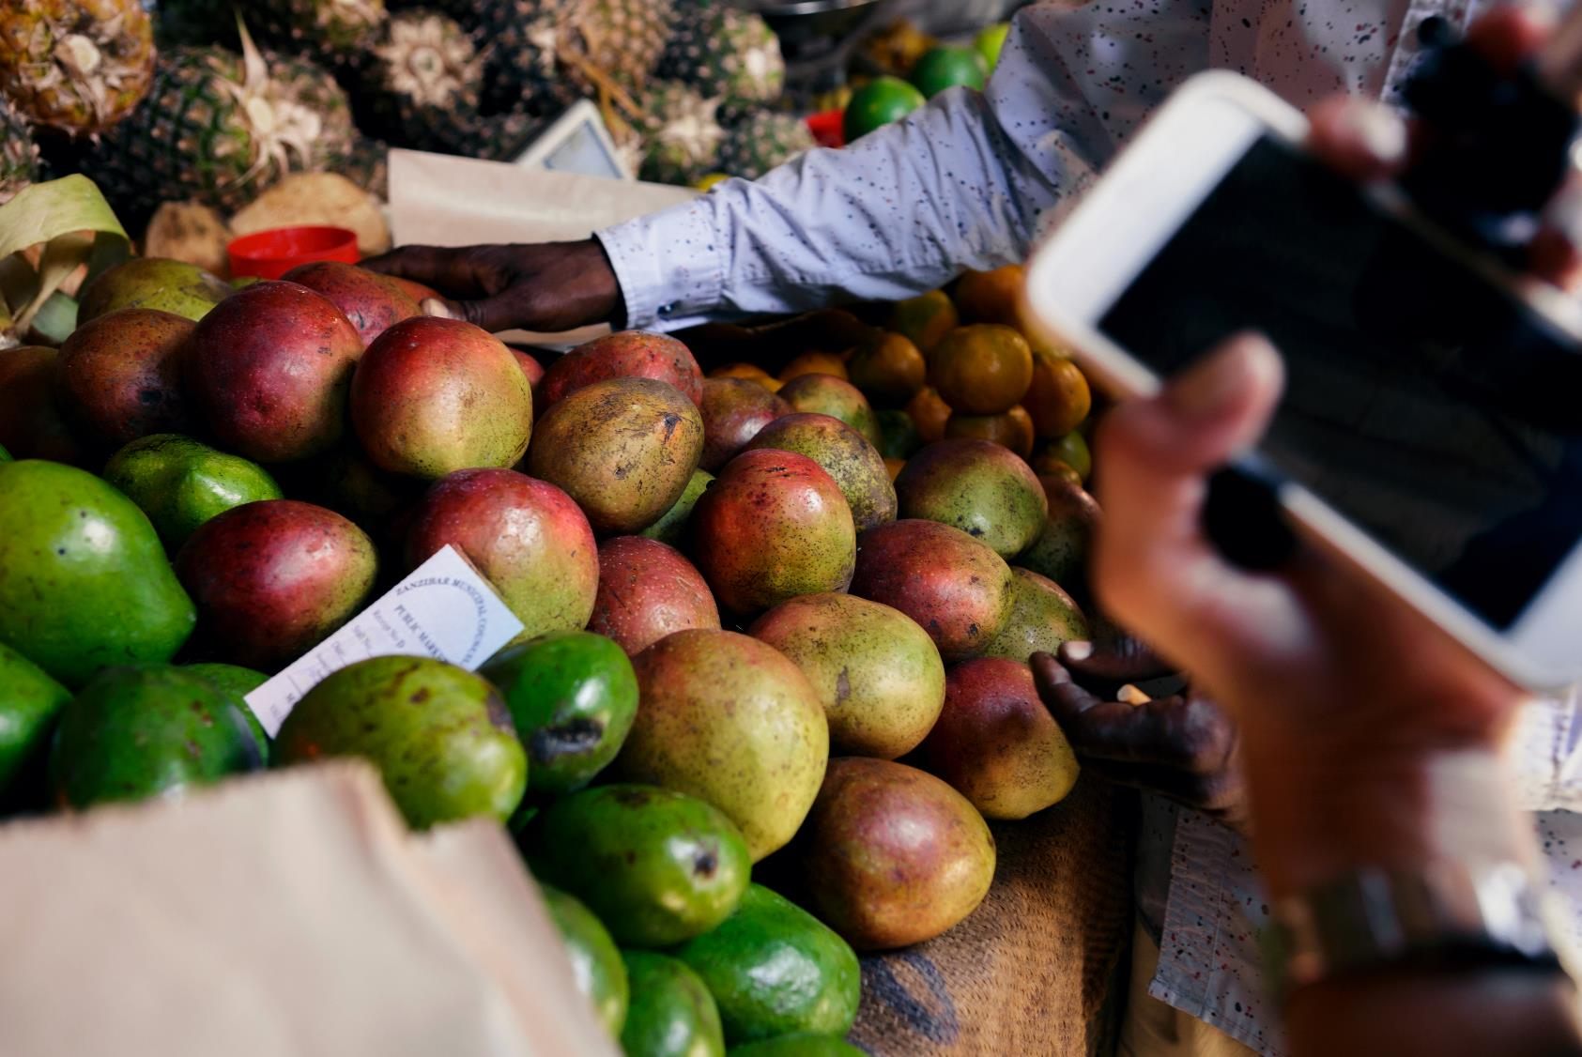
Step 8:
Monitor
Results

Slide 70
How do you know if your interventions are working?
By mapping out activities and corresponding outputs, outcomes and impact, you can communicate the programme logic and better understand what indicators will help you understand if the programme is achieving stated objectives
Levers
Activities
Outputs
Outcomes
(example outcome, for many activities/outputs there will be more than one)
Impact
Social Services & Safety Nets | Company partners to offer a pension fund | Farmers have access to a source of income once they are retired from farming (# farmers participating in pension fund) | Farming families invest in their farms with more confidence, even as they grow older (% of farmers over 55 adopting suggested GAPs)
Economic Development | Company partners to organize a Village Savings and Loan Association (VSLA) | Farming families have a trusted and secure way to save money (# farming families participating in a VSLA) | Farming families are better able to recover from shock (#/% of farming families who indicate they were better able to recover from last shock)
Price | Company introduces premiums for quality | Farming families receive a higher price for quality (# of farmers eligible for receipt of premium) | Farmers increase income from primary crop (% increase in farmer income from primary crop)
Productivity | Company provides farmer training | Farmer receive technical assistance (% farmers who receive agronomic training at least twice per month) | Farmers increase productivity (% increase in yield)
Lower Cost of Living | Company provides home garden training | Farmers receive technical assistance on planting home gardens that improve nutrition (# of farming families receiving training) | Farmers decrease amount spent on food (% decrease in costs associated with food due to eating food produced at home)
Potential household income
OTHER SOURCES OF INCOME
NET OFF-FARM INCOME
Farmers earn a living income
PRIMARY CASH CROP INCOME
OTHER INCOME
NET OFF FARM INCOME
SECONDARY CROP INCOME
NET FARM INCOME
PRODUCE CONSUMED AT HOME

Slide 71


Measurement & Evaluation for Living Income
?
?
?
What are your project objectives and how do you plan to achieve them?
What indicators will help you understand if you are reaching your objectives?
What do you need to know to understand if your activities are contributing to intended changes?
Impact
ultimate change
(i.e. change in income)
Outcome
the resulting change
(i.e. change in knowledge / skills / behavior)
Output
how many participate / how many services/resources provided
Activities
the ways company supports farmers
Notes:
How do you know if your efforts are working to close the gap? When working to improve producer income, assets and resilience it is imperative to track progress as a way of understanding if interventions are working, to be able to improve where possible and to be able to share results to tell the story of your sustainability efforts. An affordable way to measure progress is critical for most companies, who will want to focus investment on supporting farmers while also building effective information feedback loops.
First, sit down with colleagues to understand WHAT you want to measure and WHY (i.e. how will this information be useful). Start by mapping out project objectives and designing indicators that help you to understand if you are reaching your set company targets. Depending on your needs, your company may use just quantitative data (generally obtained through a survey) or both quantitative and qualitative data (a mix of survey, focus group and interview data). Data can be collected over a range of indicators, covering productivity, quality, income, food security, resilience and other livelihood elements.
For more information on performance measurement in smallholders supply chains, including guiding questions and indicator areas, see Sustainable Food Lab. A Shared Approach to Performance Measurement: Common Indicators and Metrics. 2016.

Slide 72
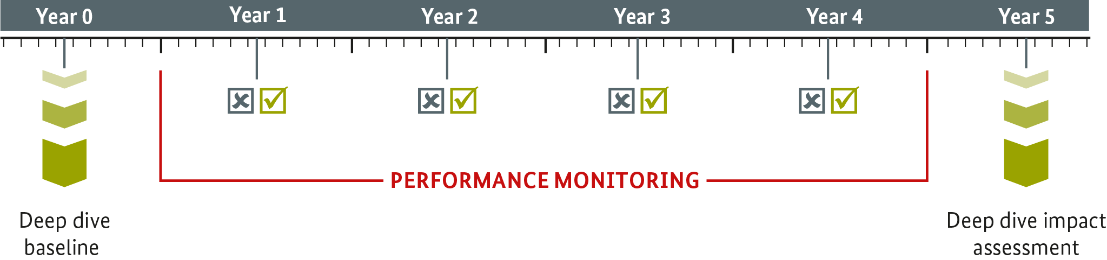
A 5 Year Timeline
Data collection over a range of indicators
Drawing on data from existing regular sources in the system (such as certification audits or supplier data)
or through fast and affordable survey techniques
Changes are measured by tracking change over time, not from control groups comparison
Household surveys are often designed to be straightforward, relatively quick and easily administered by local enumerators
Important to share information with households to validate & promote farmer learning
Notes:
Performance measurement can be useful for a single study to measure the state of producers at a particular point in time (such as adoption of good agricultural practices, yield or income),
and for subsequent measurements to identify whether activities are being accomplished as expected and whether the main outcomes are moving in the right direction. This is particularly relevant for understanding the effects of your company’s adaptation of business practices to directly improve farmer income, or supply chain innovations aimed at building producer assets and resilience. This approach can allow for some general analysis of correlation between the adoption of better management practices and specific outcomes (e.g. crop yields), but is not necessarily rigorous enough to demonstrate the attribution of outcomes to specific activities. Attribution questions – how much change can be attributed to a specific intervention – can possibly be included in more rigorous methods, including counterfactual groups for comparison.

Slide 73

Example
Mondelez and Cocoa Life
An independent research agency is measuring the progress of the Cocoa Life programme on the ground by “conducting farmer, farmer household and community studies comparing baseline conditions to developments over at least three years”.
The KPIs include:
Net income from cocoa (men and women)
Net income from sources other than cocoa (men and women)
Cocoa productivity
Increase in women’s participation in decision-making progress
Cocoa farmers’ reduced vulnerability to external shocks
Notes:
https://www.ipsos.com/en-us/news-polls/Mondelez-Annual-Report-Publication-Cocoa-Life-2019

